Slide 1
Europe PMC and open citations
Jo McEntyre Head of Literature Services
www.ebi.ac.uk

Slide 2
Life Sciences

Slide 3

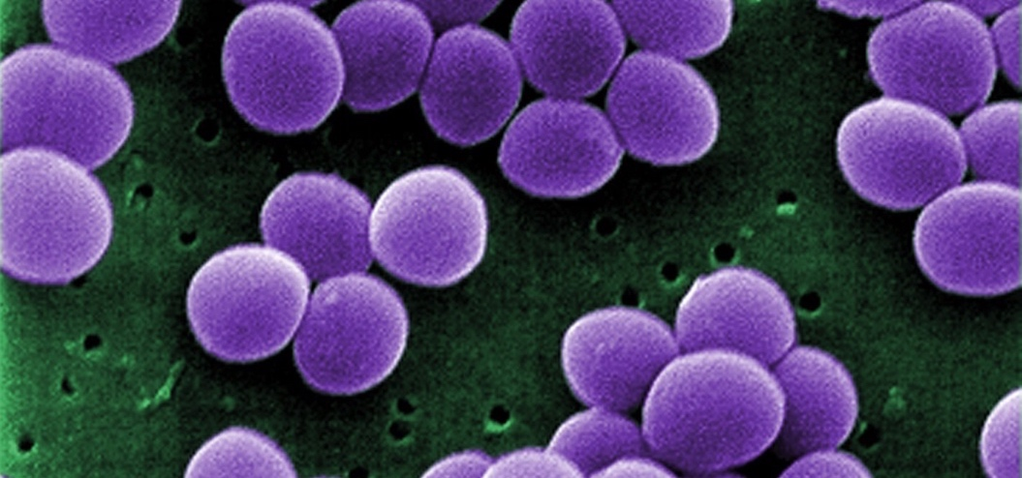
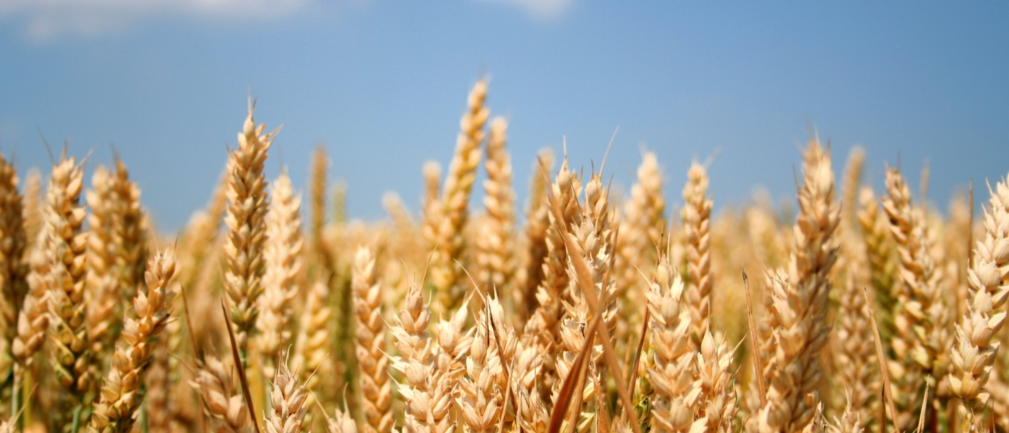

All living things are made from the same stuff
Notes:
Biology is heterogeneous, but linked by common threads of biological matter of evolution, therefore we can use a variety of different methods to probe and test those living systems whether they are bugs, people etc

Slide 4
Data resources at EMBL-EBI
Genes, genomes & variation
Ensembl
Ensembl Genomes
GWAS Catalog
Metagenomics portal
Gene, protein & metabolite expression
Expression Atlas
Metabolights
PRIDE
RNA Central
Protein sequences, families & motifs
InterPro
Pfam
UniProt
Molecular structures
Protein Data Bank in Europe
Electron Microscopy Data Bank
Literature & ontologies
Experimental Factor Ontology
Gene Ontology
BioStudies
Europe PMC
Chemical biology
ChEBI
ChEMBL
SureChEMBL
Systems
BioModels
BioSamples
Enzyme Portal
IntAct
Reactome
Molecular Archives
European Nucleotide Archive
European Variation Archive
European Genome-phenome Archive
ArrayExpress
Notes:
Indeed, in the life sciences we have a suite of databases in which data of certain types should be deposited, from genomics to expression protein structure data

Slide 5
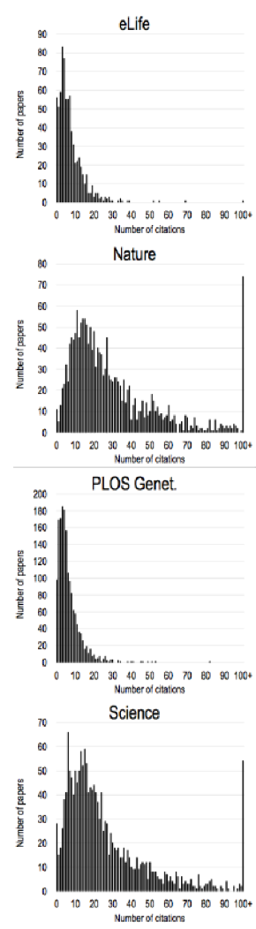
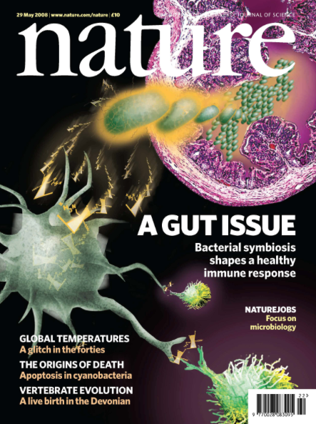


Publishing, credit and attribution in the life sciences
Journal publishing (not monographs, preprints or conf proc)
Impact factors
Cutting edge
Article level metrics
Alternative forms of credit e.g. for data sets
Emerging interest in preprints

Slide 6

7000 full text journal titles

Slide 7
Europe PMC

Slide 8

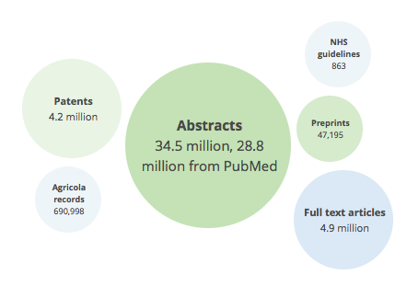
Europe PMC
Partnered with PubMed Central USA
29 Funders
+ APIs

Slide 9


Slide 10
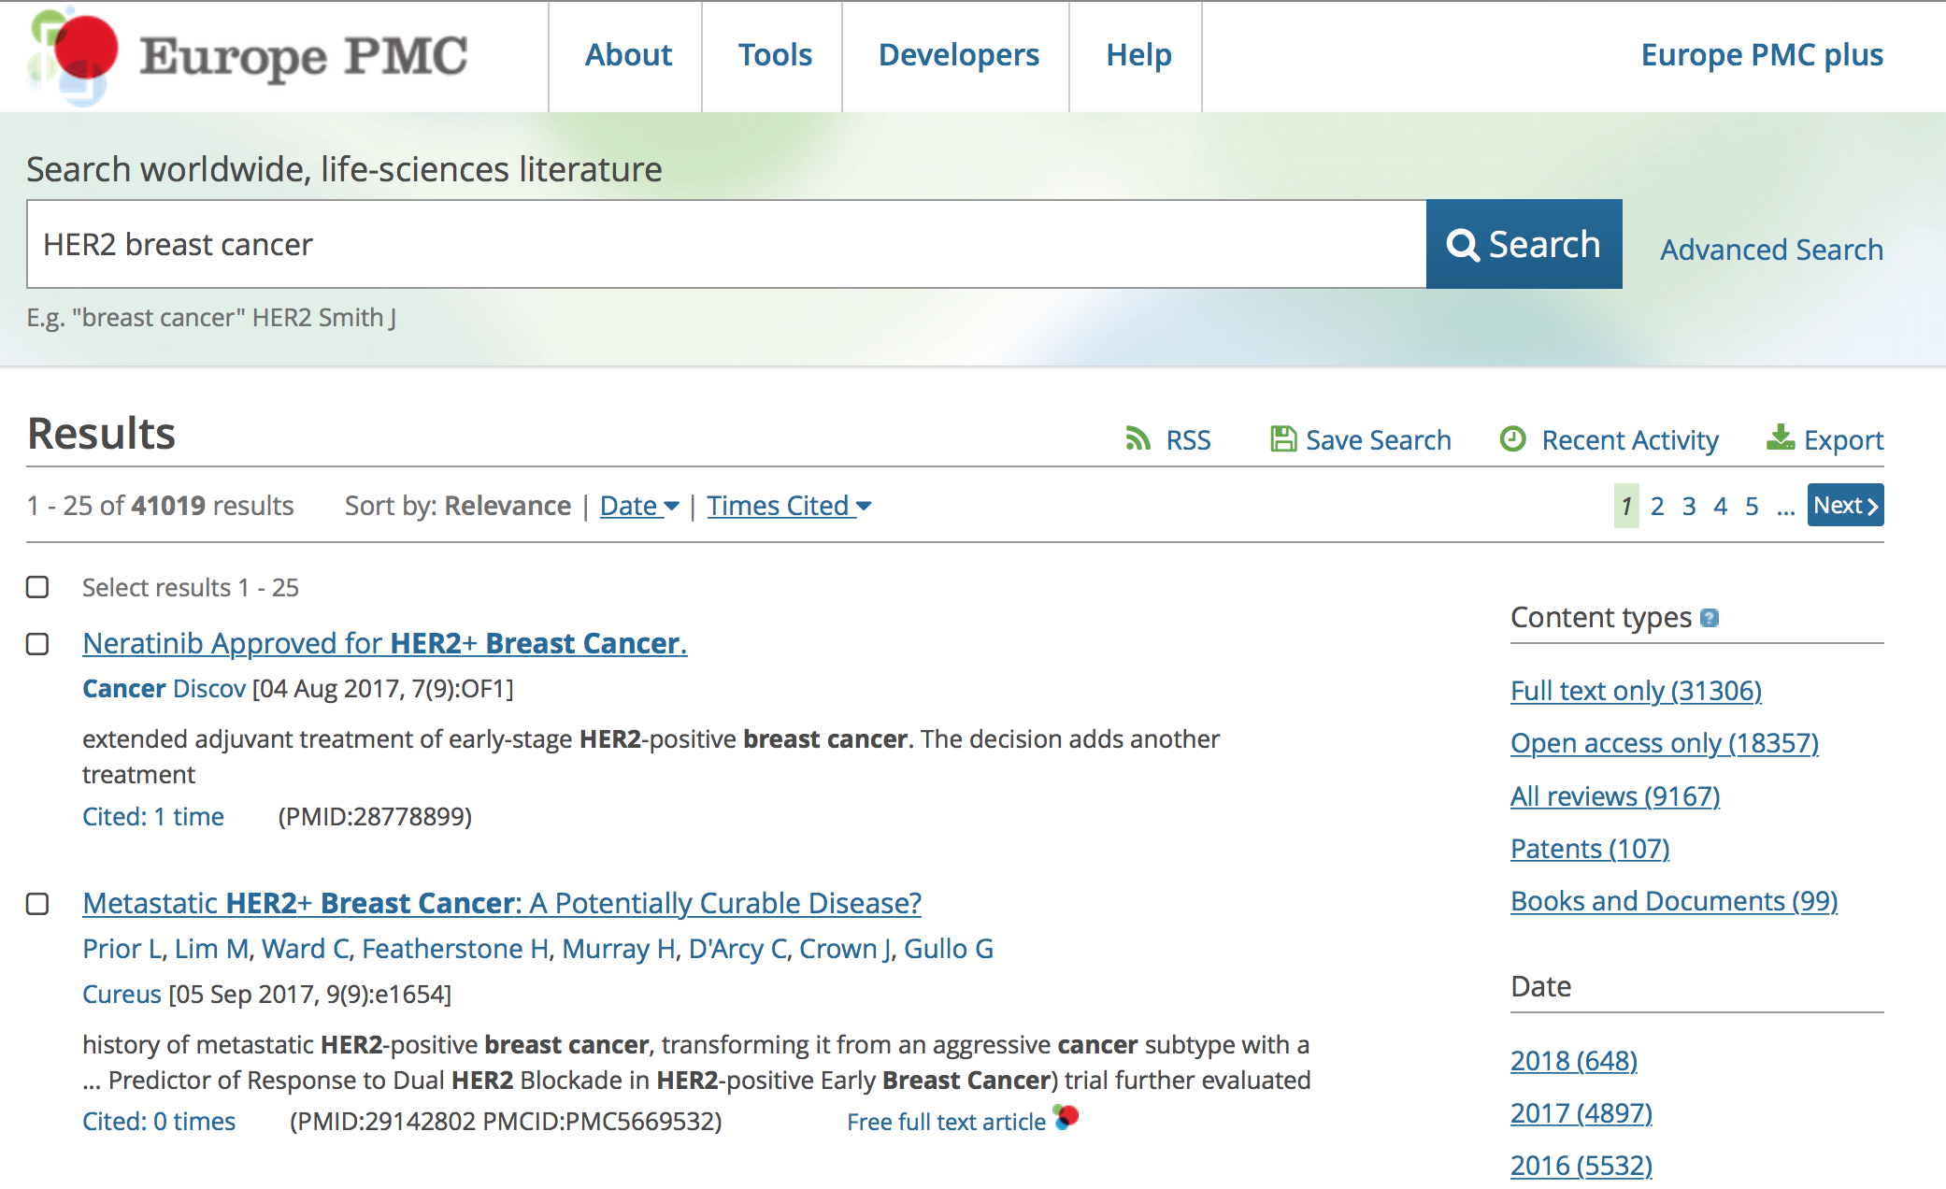
Powerful search based on rich metadata

Slide 11
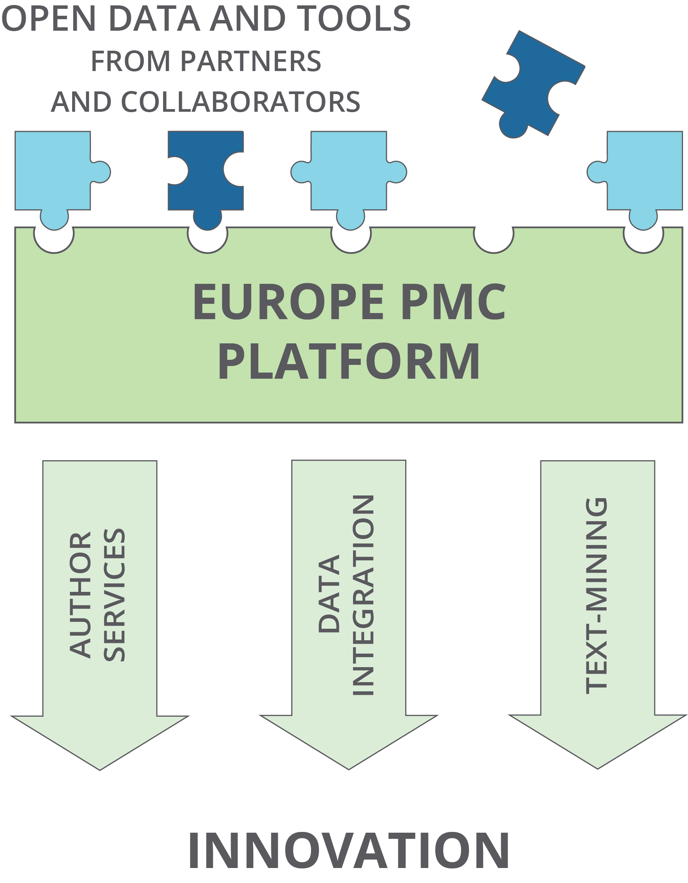
Maximizing reuse of research
Europe PMC is an open community platform
Specialist scientific knowledge allows rich services and community engagement
European science context

Slide 12
Citations

Slide 13




Citation Network Processes
Total matched citations
Total citing articles
Citation Matching
Priority
Source
96 million
2.8 million
PMID or DOI, then strict match on journal abbreviation, ISSN, volume, page numbers etc.
1
PubMed Central full-text XML
DOI prefix, then fuzzy match journal abbreviation, ISSN, volume, page numbers etc.
2
226 million
10.3 million
Crossref OAI-PMH
3
13.6 million
0.84 million
PMID then DOI
PMC pre-compiled citations
20% unmatched
Notes:
The Europe PMC citation network is derived from three sources: 1) PubMed Central (PMC) full-text XML files; 2) Crossref OAI-PMH metadata service; 3) PMC OCR reference lists.
We run the PMC citation pipeline daily, and Crossref weekly. If a reference list for the same citing article arrives from multiple sources, we prioritise in the following order: PMC full-text, then Crossref, then PMC OCR.
N.B. The PMC pre-compiled content is in part a compiled citation list from PMC full-text, but also part of a back-digitisation project where the PDFs of older articles undergo optical character recognition and reference lists are derived. PMC try to match these references to PMIDs and make these cited articles available to us. We only display the PDF in Europe PMC for these articles and don't have the XML.

Slide 14

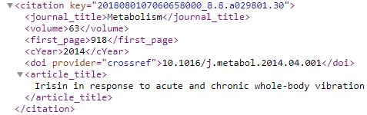
In more detail
Crossref metadata
Journal in Europe PMC?
NO
YES
Crossref OAI-PMH
Article in Europe PMC?
NO
oai.crossref.org:80/OAIHandler?verb=ListRecords&set=$10.1101&from=2018-08-01&until=2018-08-02&metadataPrefix=cr_unixml
YES
Reference list not already loaded from higher priority?
NO
YES
Cited article is a match?
YES
NO
Insert citation pair into “complete” table
Insert citation pair into “nonmatch” table
Repeat for each cited article
Notes:
First we query Crossref with a predefined list of publisher DOI prefixes. Then we check if the journal and then each citing article is available in Europe PMC. Next we check for priority. Then for each entry in the bibliography we try to make a match to another existing article in Europe PMC. Each match is stored in our main ORACLE database as an ID pairs of the "citing" article, and the "cited" article. If we're unable to match a citation pair, we store the pair in a NONMATCH table.
We make this citation information available via our webservices and on our front-end. We show individual citations counts for all publications in Europe PMC and display the both the cited and citing publications on the Europe PMC website.

Slide 15
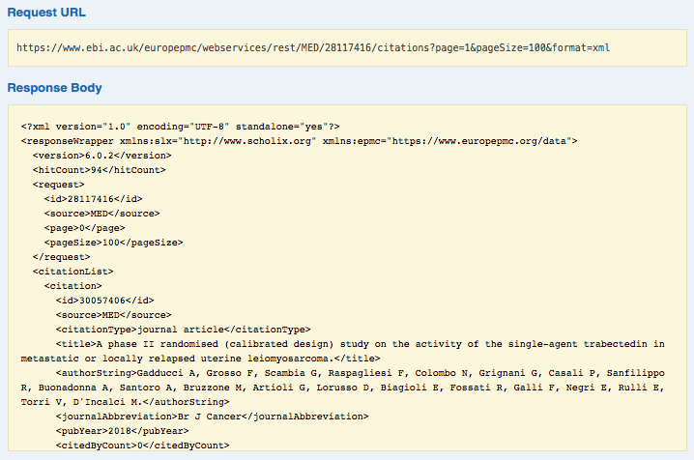
API

Slide 16
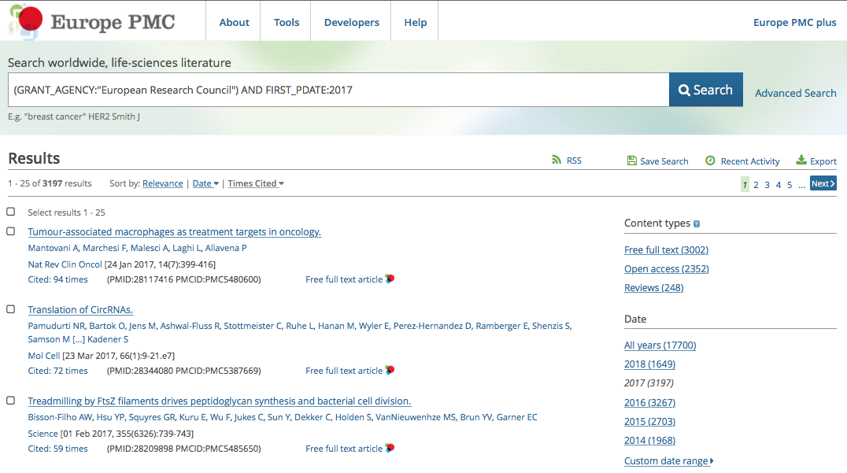
Citation sort order

Slide 17
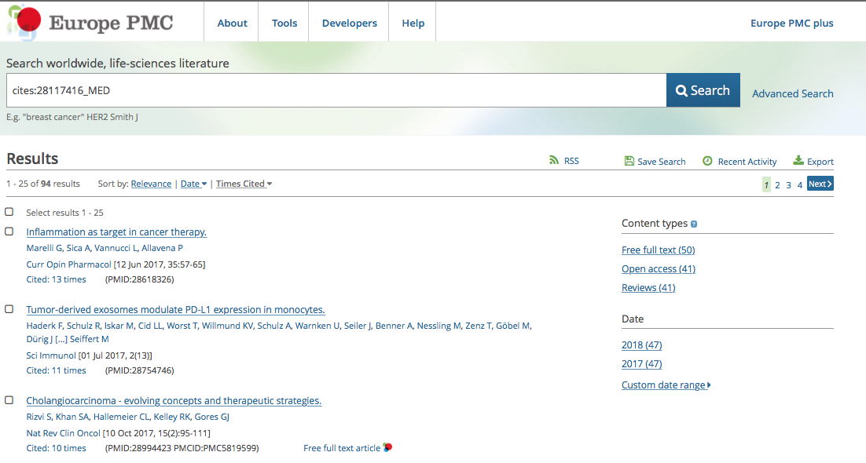
Citing articles …

Slide 18
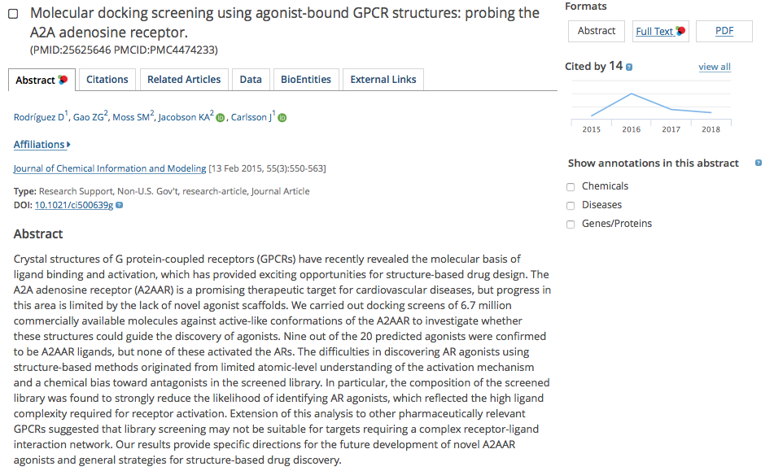
Citations by year

Slide 19

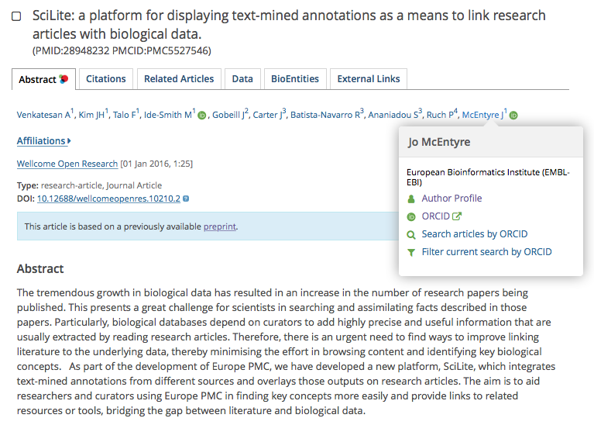
Combining Open Data
850K ORCID iDs, 6M papers

Slide 20
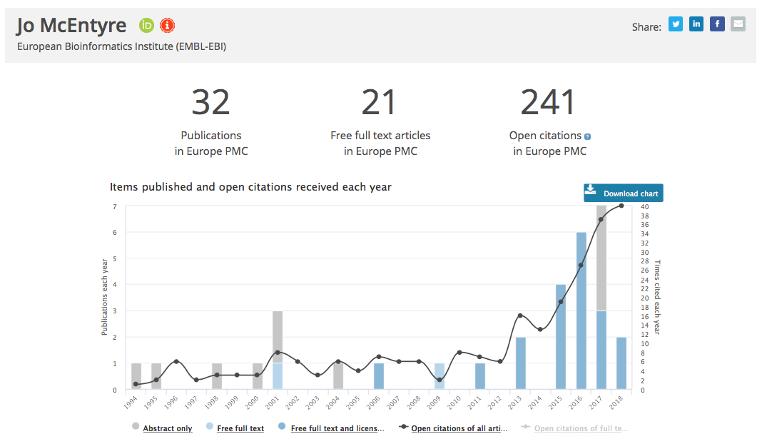
Author profiles

Slide 21
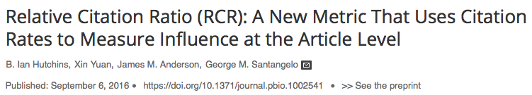
Scientists like big numbers
Why do articles in Europe PMC list fewer citations than other citation information services?

Slide 22
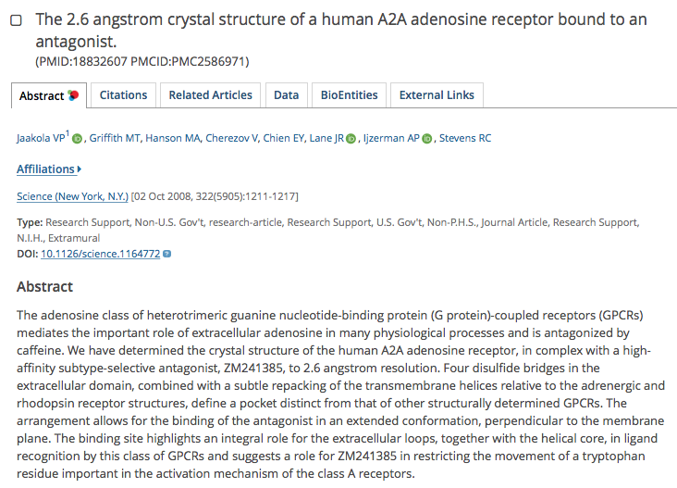
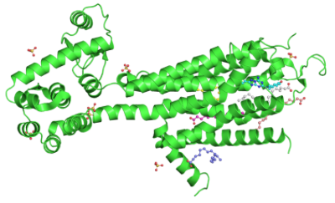
Paper citations, data citations
PDB record: 3EML
3EML
210 mentions
838 citations
64
692
146
ACCESSION_ID:3EML OR CITES:18832607_MED
902

Slide 23
Preprints

Slide 24

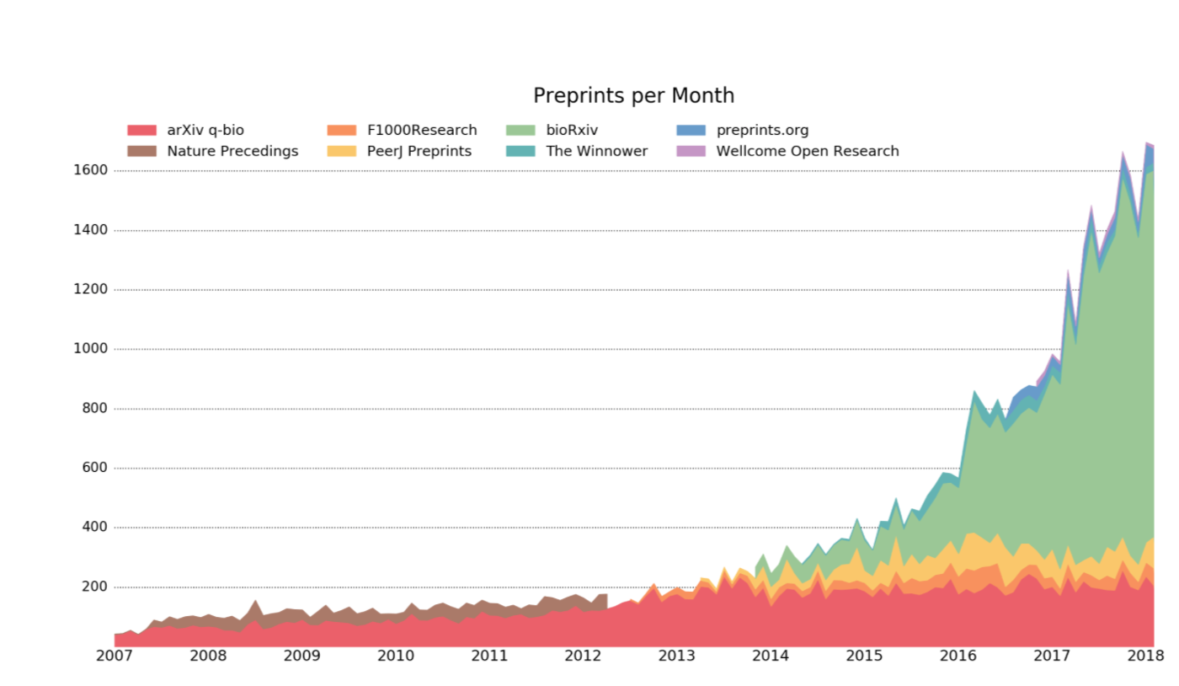
Jordan Anaya

Slide 25
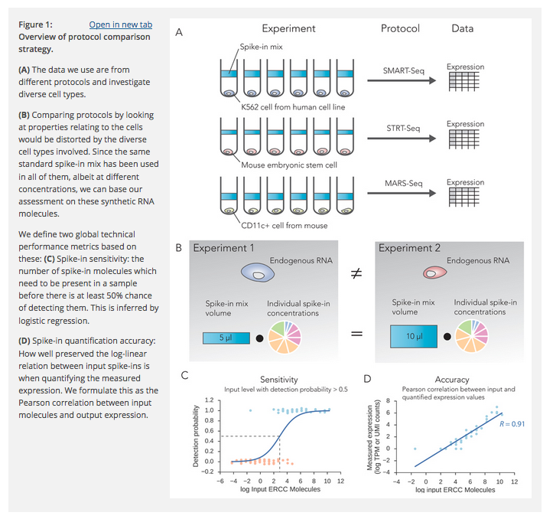
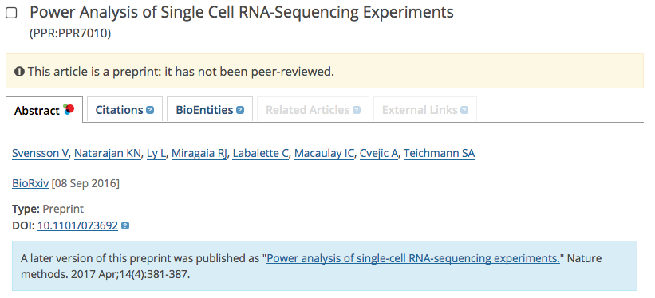
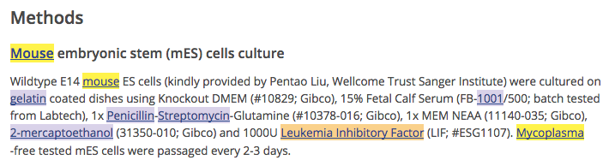
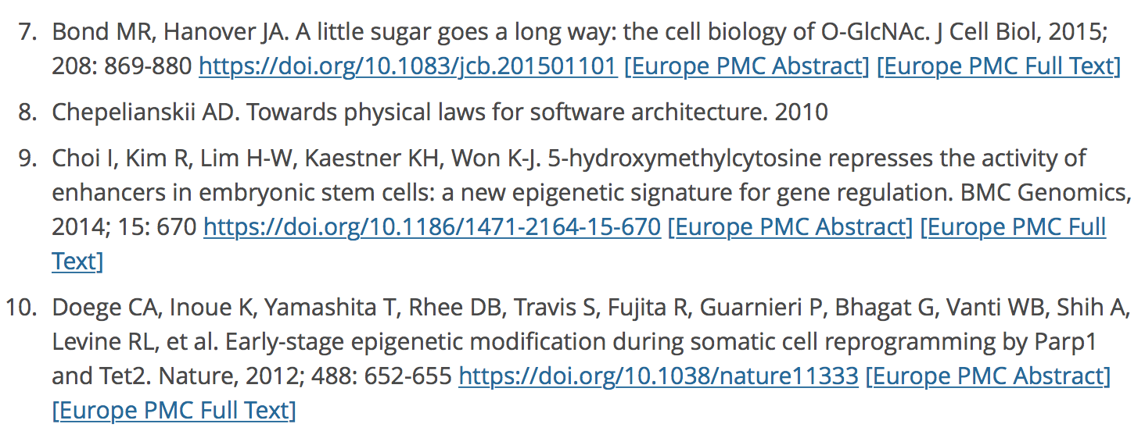
Preprints in Europe PMC
47K abstracts
No ref lists
Crossref OAI-PMH

Slide 26
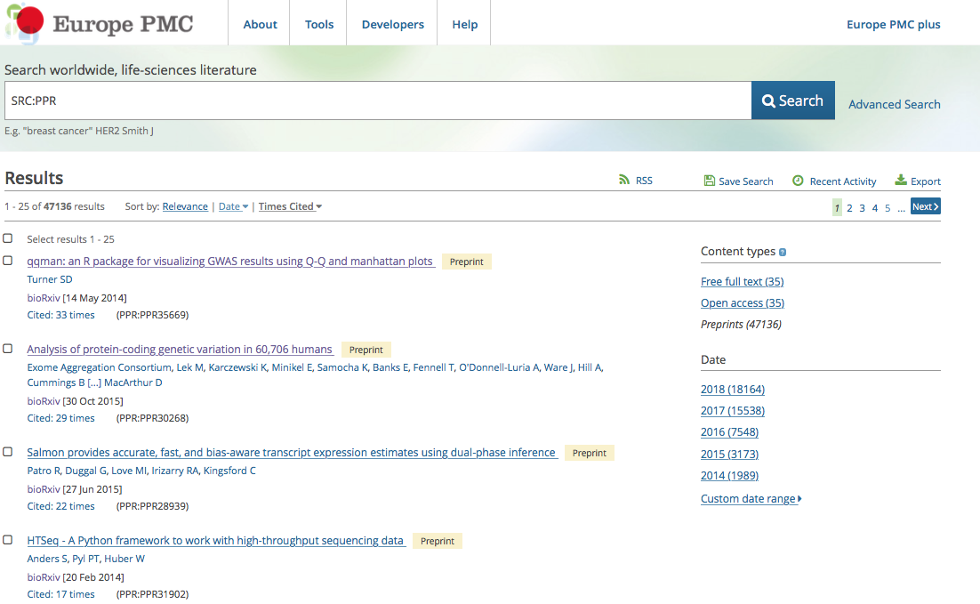
Preprints are cited too

